Slide 1
Marvell xDSP Test List
Stephen Peck Kris Hublitz

Slide 2
Today’s Test List
PAM4 Without MultiLane
Firmware Download Successful
Setup Successful
PRBS Lock
PRBS LSB BER
PRBS MSB BER
PRBS Signal to Noise Ratio
PAM4 With MultiLane
Critical Metrics
Firmware Download Successful
Setup Successful
SNDR - Industry Standard PAM4, NRZ uses Jitter
Eye Height(s)
Eye Width(s)
RLM94 ### Informational Metrics
Eye Voltage Levels (zero, one, two and three)
Eye Min and Max Voltage
Peak to Peak Voltage
Eye Base and Top
Eye Amplitude

Slide 3
Loopback Options
Dual PRBS

Slide 4
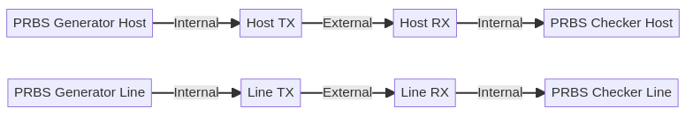

Slide 5
Egress or Host to Line

Slide 7
Ingress or Line to Host

Slide 9
Desired Support for Future Efforts
Masking for each eye
Offline capability with waveform playback for regression testing
Reduction in overhead for adjusting CW Tone Output

Slide 10
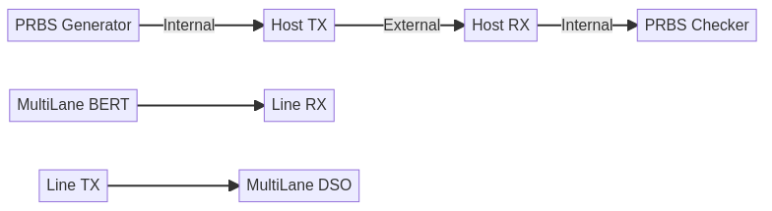
MultiLane Hardware Configuration

Slide 11
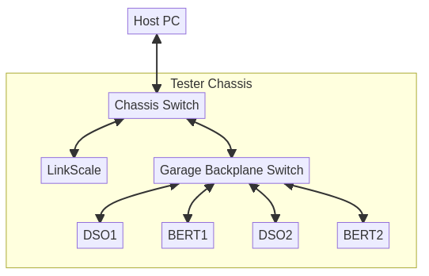
Tester Network Configuration

Slide 12
